Slide 1
WORLD OF DRONE
Drone Application: Filming

Slide 2
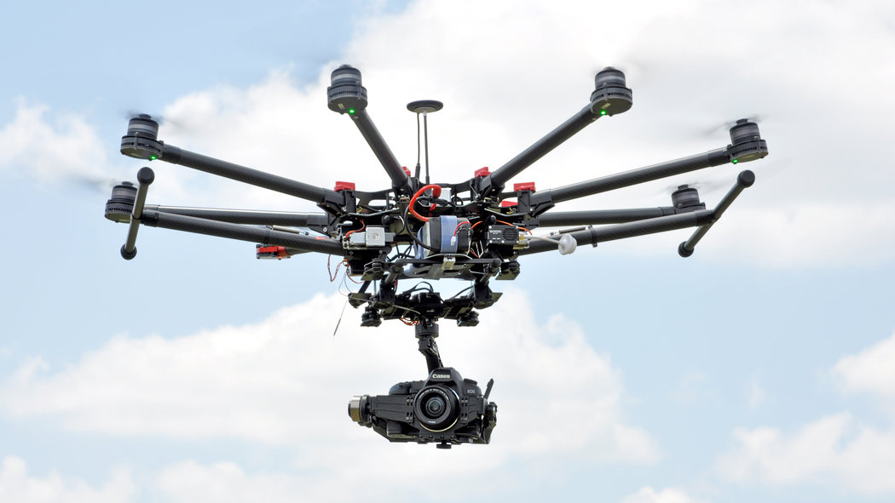
Drone Application: Filming
Use of UAVs for filmmaking is generally easier on large private lots or in rural and exurban areas with fewer space constraints.

Slide 3
Drone Application: Filming
Companies argue that low-cost drones could be used for shots that would otherwise require a helicopter or a manned aircraft, saving money and reducing risk for pilot and crew.

Slide 4
Drone Application: Filming
UAVs have been used to film sporting events, such as the 2014 Winter Olympics, as they have greater freedom of movement than cable-mounted cameras.

